Slide 1



Bluemix Demo
MoodLocator

Slide 2
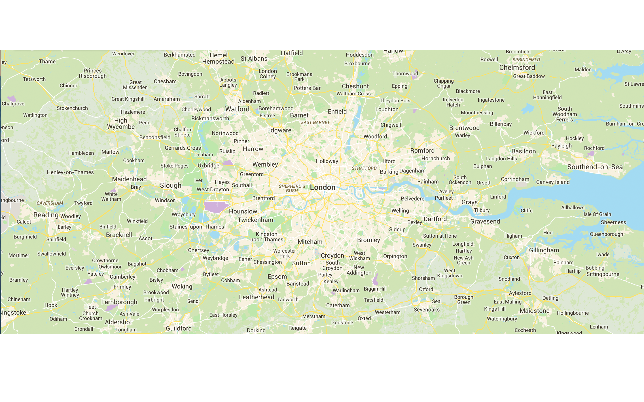

Google Maps API
London, United Kingdom

Slide 3



Twitter Stream API
London
Berlin
User visited website 29 / 11 / 14 - 17:45

Slide 4

Google & Twitter
London

Slide 5


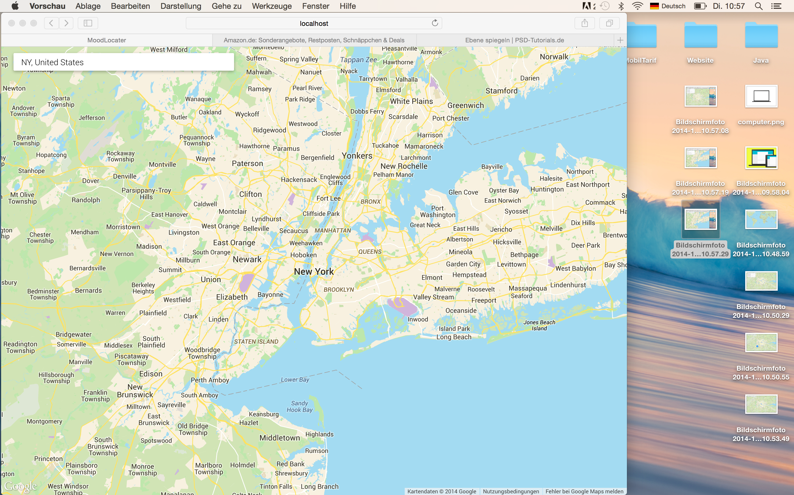
Structure
Maps API
Stream API
Lokal

Slide 6
Structure
Maps API
Stream API
.js
Bluemix

Slide 7
Twitter Locator
London, United Kingdom
UserName
Tweet Text Tweet Text Tweet Text Tweet Text Tweet Text Tweet Text

Slide 8
Structure
Maps API
Stream API
.js
Bluemix

Slide 9
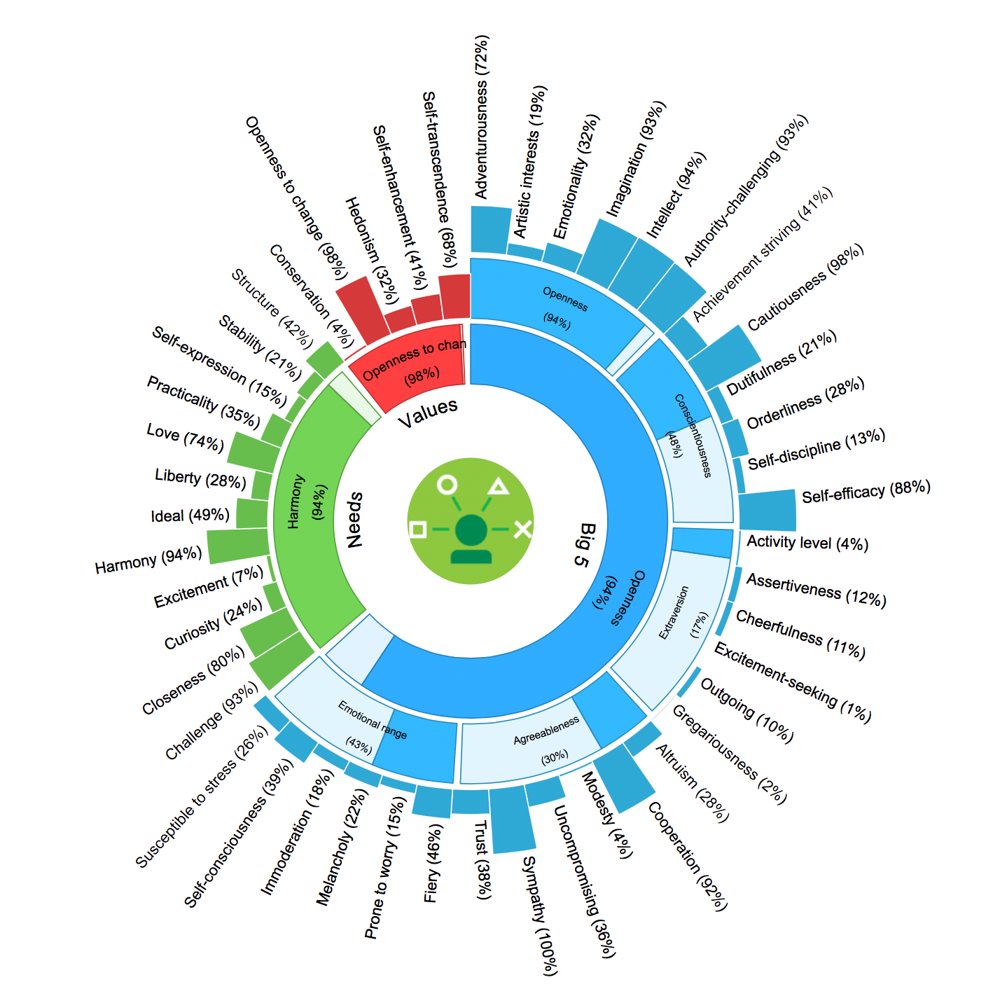

User Modeling Service
Possible character of the author
Text - at least 100 Words
BETA:
Only english Text
Get a fully character analysis from the author
of the text
Jan-Niklas Dihlmann
November 2014

Slide 10

User Modeling Service
All Tweets from one city
BETA:
Only english Tweets
Get a fully character analysis from all the
users combined who are twittering in this city
Jan-Niklas Dihlmann
November 2014

Slide 11
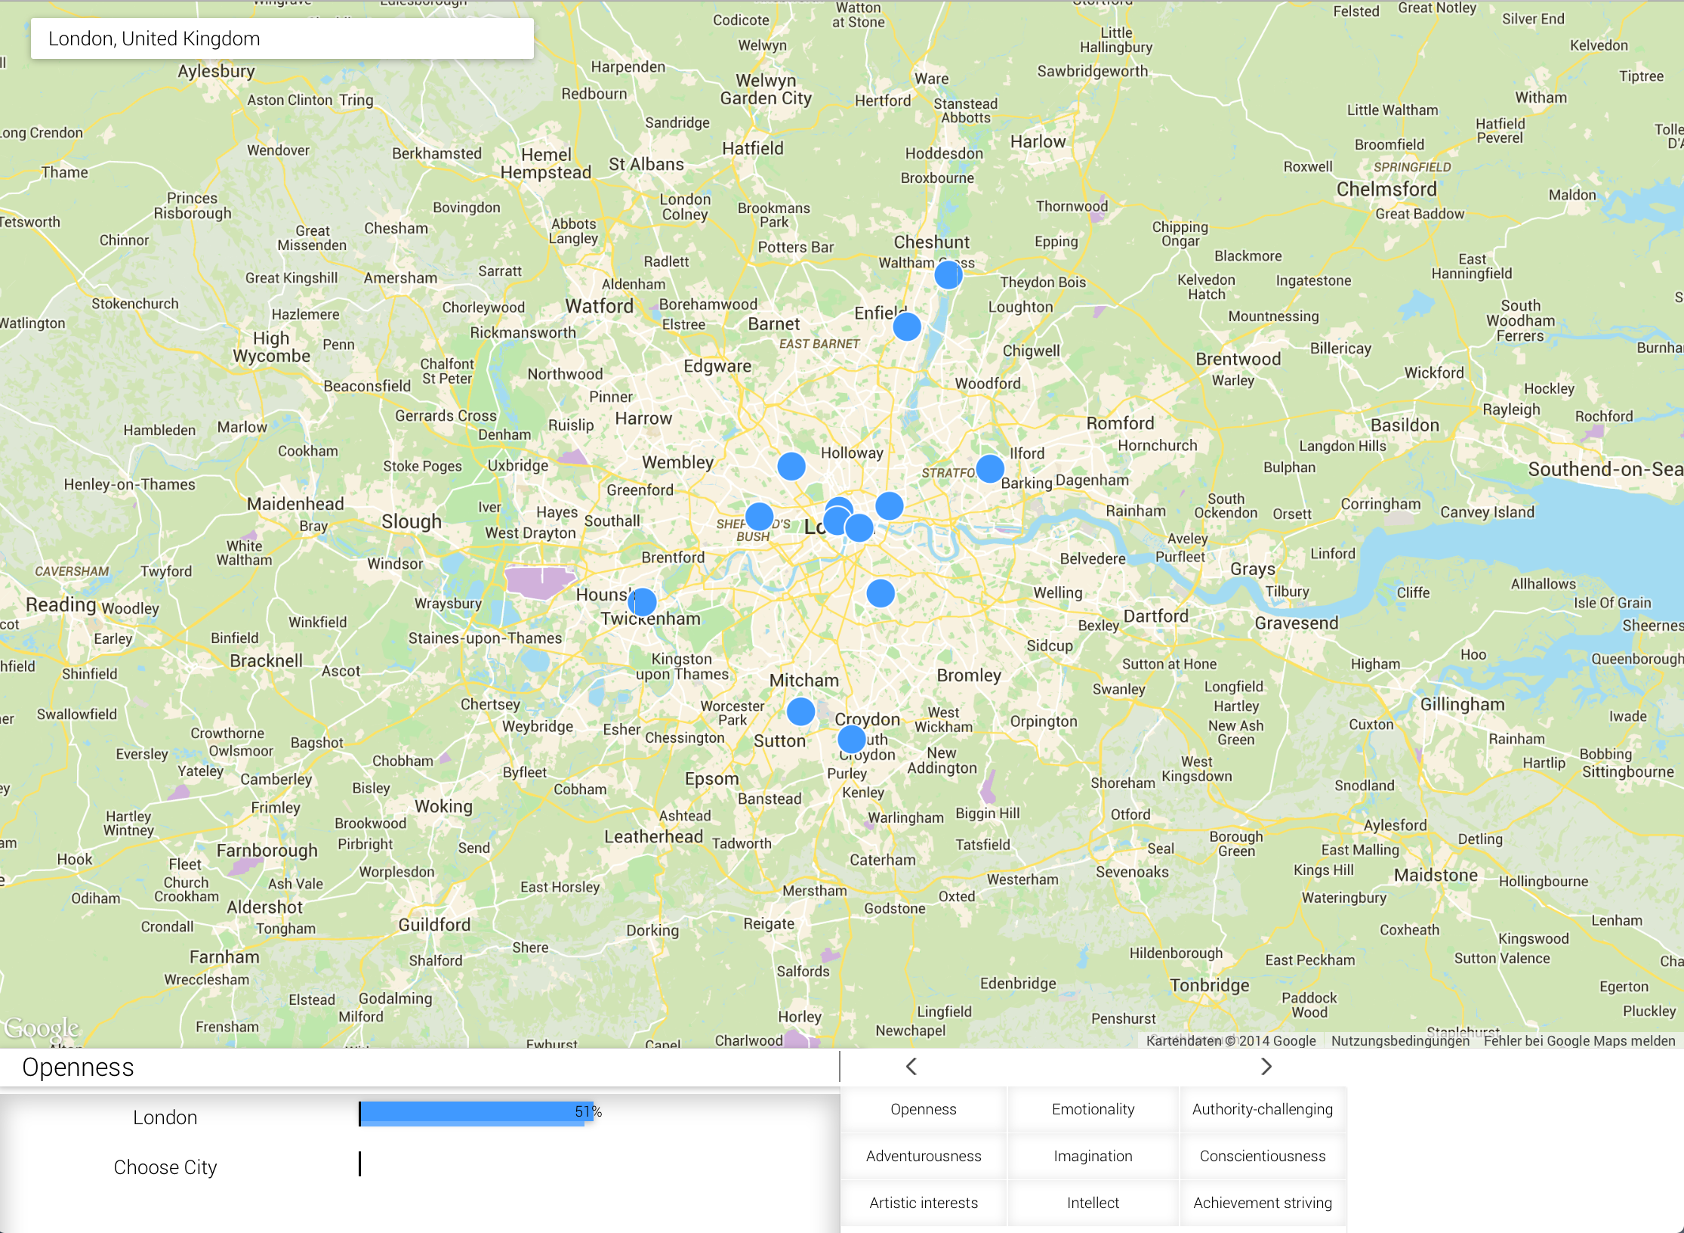
MoodLocator
London, United Kingdom
Jan-Niklas Dihlmann
November 2014

Slide 12
Tipp how to use
User Modeling Service is a BETA version, is only analyzing english words. Therefore choose a city where people twitter mostly in english.
Choose big cities like London, New York, Johannesburg.
When you hover over one Tweet, only hover over the next Tweet after the first one closes.
Test it yourself, enter your current location and send a Tweet with text and geolocation. Try to find it. Have fun and enjoy it!
Jan-Niklas Dihlmann
November 2014

Slide 13
MoodLocator
Bluemix: moodlocator.mybluemix.com
GitHub: /JDihlmann/moodlocator

